Slide 1

A Tale of two Machine-learning Methods
Matt Miller & Kai Blumberg
INFO 523 Final Presentation

Slide 2

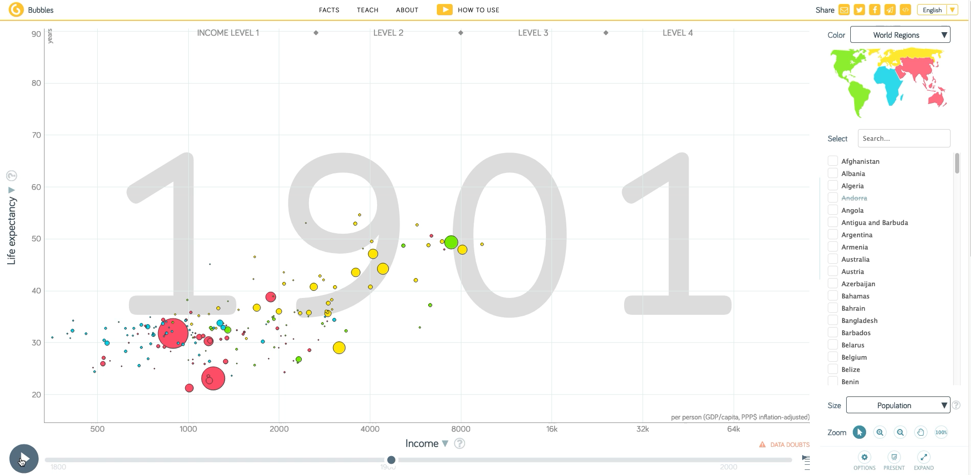
Gapminder “Fact Tank”
Open source global datasets
Widely used
Census style
Easy to use and understand
Gapminder is a non-profit venture – a modern “museum” on the Internet – promoting sustainable global development and achievement of the United Nations Millennium Development Goals.
Fighting devastating ignorance with fact-based worldviews everyone can understand.

Slide 3
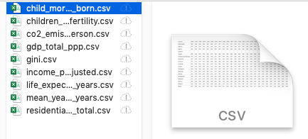



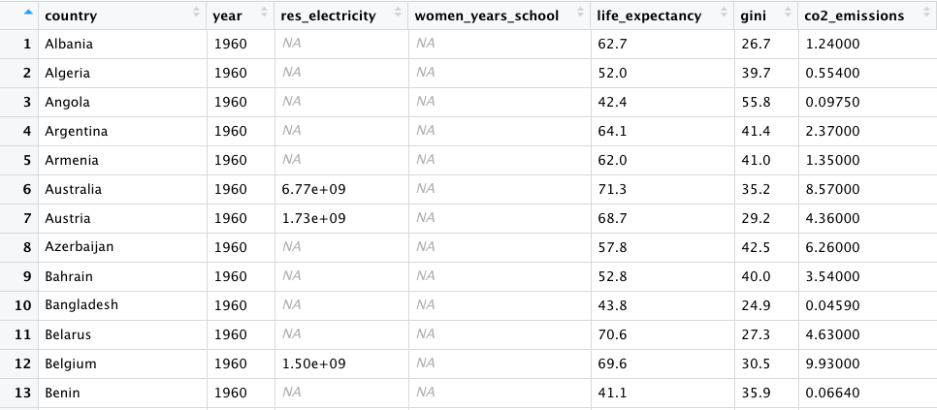
Data preprocessing
Data preprocessed using tidyverse
Parsed 9 features into a “Long Data Frame” format
Filter missing data
Data transformations
“min max” normalization
“log” normalization
…
…

Slide 4
Features selected
All numeric features
Child mortality (aged 0-5 deaths per 1000 born)
Total fertility (children per woman)
CO₂ emissions (tons per person)
Gross Domestic Product (GDP) total Purchasing Power Parity (PPP)
Gini Coefficient: measure of income inequality (Higher means more inequality)
Income per person (GDP per capita PPP inflation adjusted)
Life expectancy (years)
Mean years women in school (15-24 year old)
Residential electricity use total (Kilowatt-hours)

Slide 5
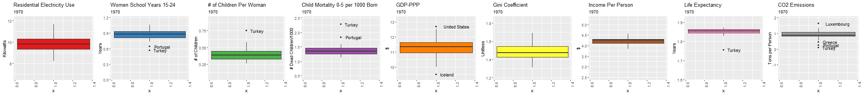
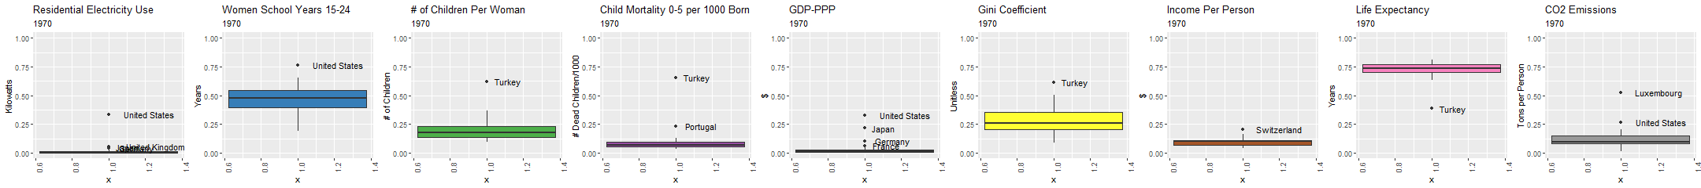
Our dataset, visualized (1970-2008)
LOG NORMALIZATION
MIN-MAX NORMALIZATION

Slide 6
Clustering Methods
Preprocessing:
Filter missing data and select the year 2008
Kmeans
Cluster center calculated as mean of points in cluster
Used Euclidian distance
Partitioning Around Medoids (PAM)
Aka K-medoids
Data points serve as centers (medoids)
Used Gower distance
Calculated Silhouette Width to estimate K
Measure of how similar an object is to its own cluster compared to other clusters
High values indicate good matching of object to own cluster
Clusters Visualized using T-Distributed Stochastic Neighbor Embedding (t-SNE)
Ordinates multidimensional data into lower number of dimensions
Both Take hyperparater K number of cluster to form

Slide 7
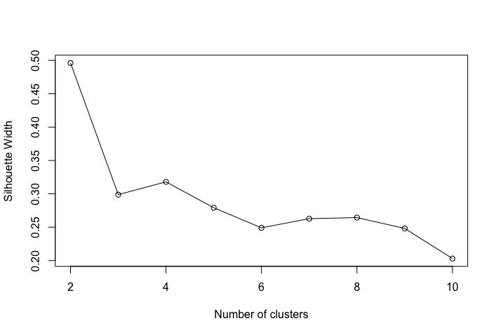
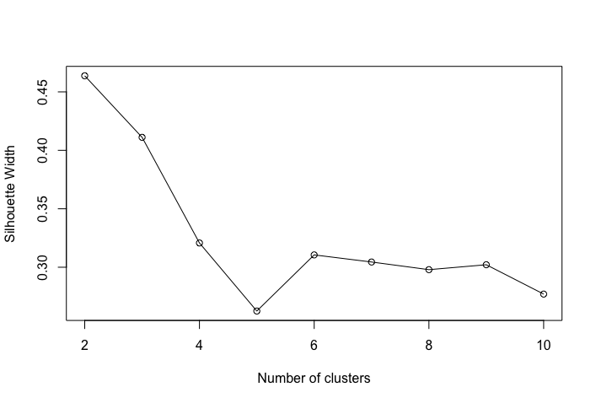
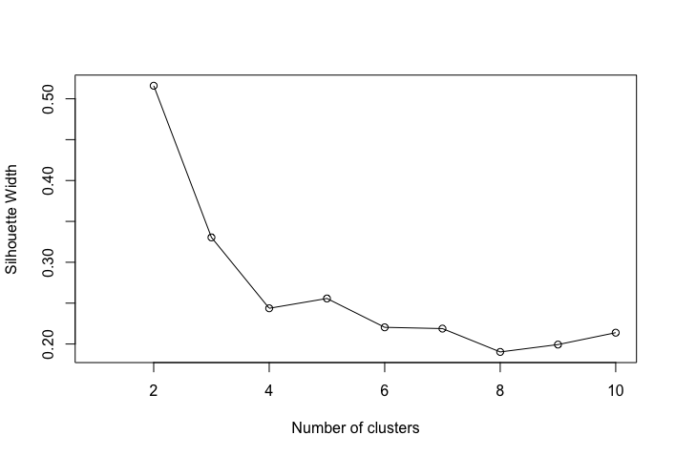
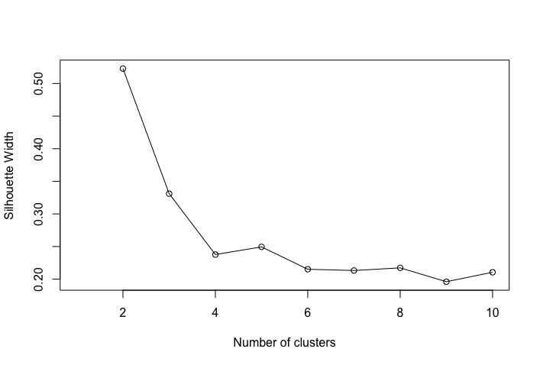
Silhouette width
Min max normalization
Log normalization
Kmeans
PAM

Slide 8
Confusion Matrices PAM vs Kmeans
Min max normalization
Log normalization
2 Clusters
PAM
PAM
 | 1 | 2
1 | 92 | 0
2 | 2 | 30
 | 1 | 2
1 | 59 | 34
2 | 5 | 26
Kmeans
Kmeans
PAM
PAM
3 Clusters
 | 1 | 2 | 3
1 | 54 | 0 | 1
2 | 2 | 5 | 40
3 | 0 | 22 | 0
 | 1 | 2 | 3
1 | 15 | 30 | 10
2 | 20 | 18 | 9
3 | 20 | 2 | 0
Kmeans
Kmeans

Slide 9
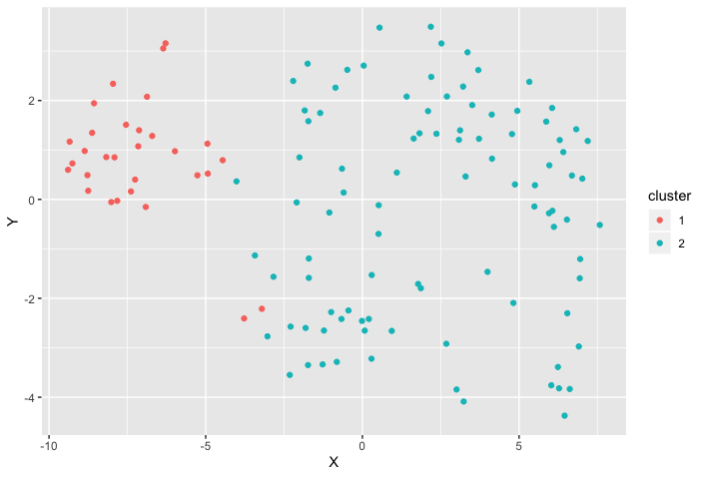
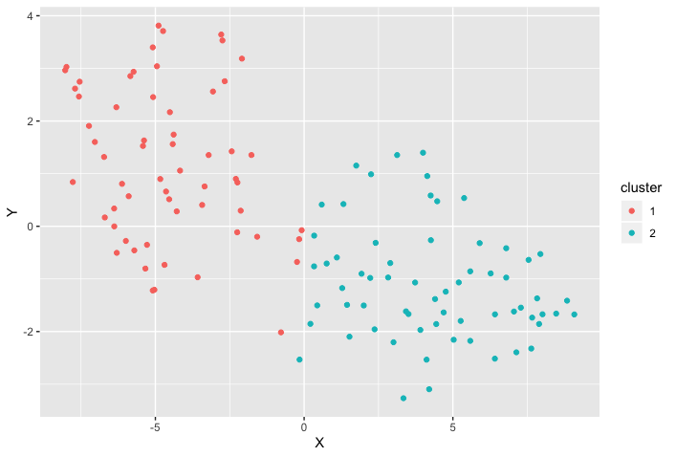
Kmeans k = 2
Min max normalization
Log normalization

Slide 10
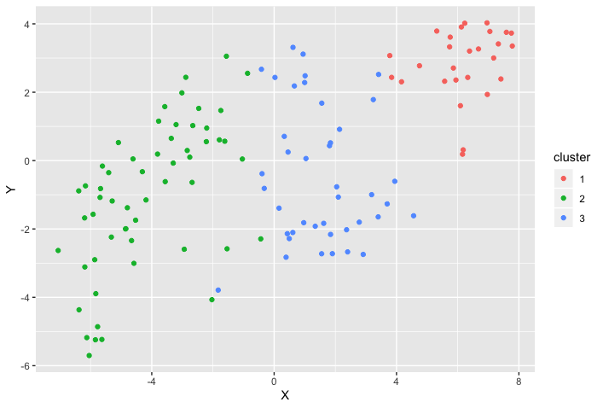
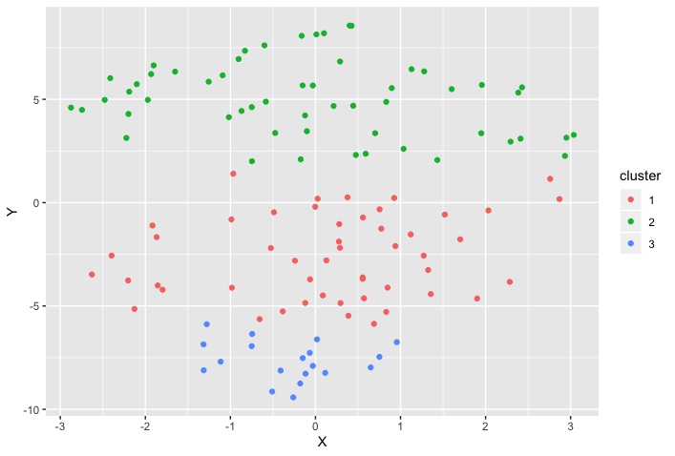
Kmeans k = 3
Min max normalization
Log normalization

Slide 11
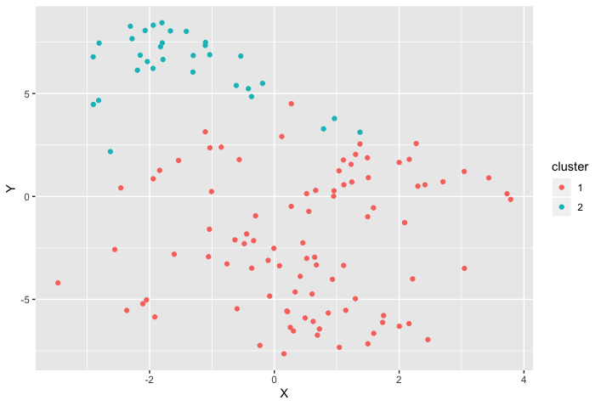
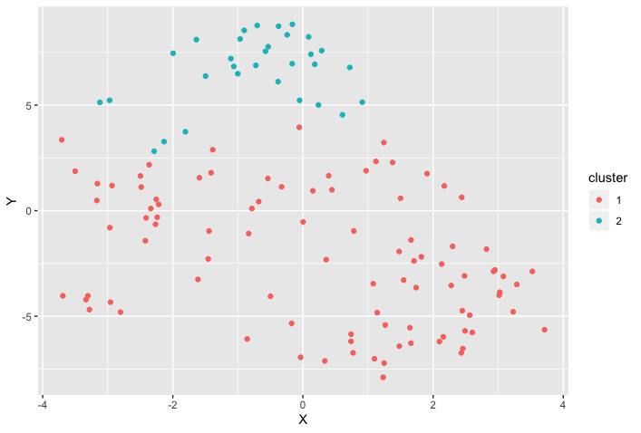
PAM k = 2
Min max normalization
Log normalization

Slide 12
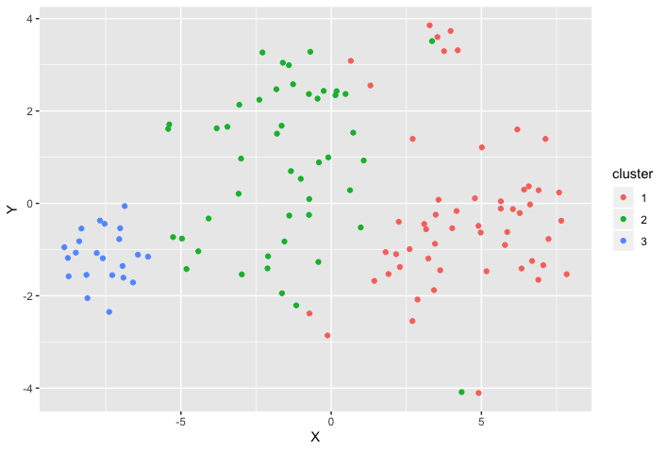
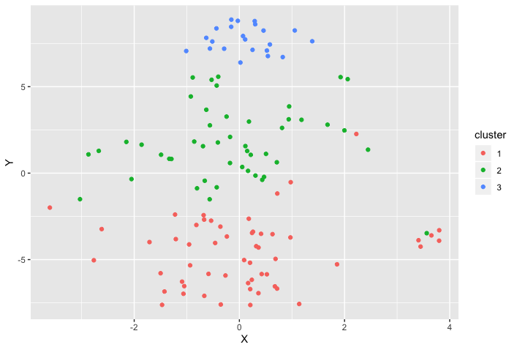
PAM k = 3
Min max normalization
Log normalization

Slide 13
PAM k = 3 Min max normalization Clusters
Cluster 1
Cluster 2
Cluster 3
Algeria
Argentina
Bahrain
Bangladesh
Bolivia
Botswana
Brazil
Cambodia
China
Colombia
Costa Rica
Ecuador
Egypt
El Salvador
Georgia
Guatemala
Honduras
India
Indonesia
Iran
Jamaica
Jordan
Libya
Malaysia
Mexico
Mongolia
Morocco
Nepal
Angola
Benin
Cameroon
Congo, Dem. Rep.
Congo, Rep.
Cote d'Ivoire
Eritrea
Ethiopia
Gabon
Ghana
Haiti
Kenya
Mozambique
Myanmar
Nigeria
Pakistan
Senegal
Sudan
Tanzania
Togo
Zambia
Zimbabwe
Albania
Armenia
Australia
Austria
Azerbaijan
Belarus
Belgium
Bosnia and Herzegovina
Brunei
Bulgaria
Canada
Chile
Croatia
Cuba
Cyprus
Denmark
Estonia
Finland
France
Germany
Greece
Hungary
Iceland
Ireland
Israel
Italy
Japan
Kazakhstan
Kuwait
Latvia
Lebanon
Lithuania
Luxembourg
Malta
Moldova
Netherlands
New Zealand
Norway
Poland
Portugal
Qatar
Romania
Russia
Serbia
Singapore
Slovak Republic
Slovenia
Spain
Sweden
Switzerland
Trinidad and Tobago
Ukraine
United Arab Emirates
United Kingdom
United States
Nicaragua
Oman
Panama
Paraguay
Peru
Philippines
Saudi Arabia
South Africa
Sri Lanka
Syria
Tajikistan
Thailand
Tunisia
Turkey
Turkmenistan
Uruguay
Uzbekistan
Venezuela
Vietnam
European, rich Middle Eastern & “Western” countries
Poorer mostly African countries
“Mostly developed”, Middle East, North Africa, Latin America, & Asian countries

Slide 14
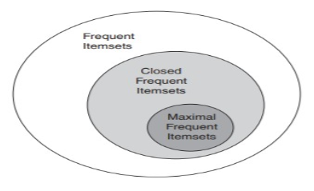
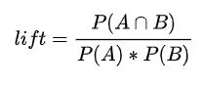
RULE LEARNING Methods
Preprocessing:
Select years 1970-2008
Bin each feature into low, medLow, medHigh, and high bins based on quartiles
Bin years into decades (70s, 80s, 90s, 00s)
Apriori
Support = 0.15, Confidence = 0.5 (Good rules)
Support = 0.2, Confidence = 0.7 (Great rules)
Mined rules from frequent and maximally frequent itemsets
Evaluate based on lift
Notes:
Confidence = prob of B given A = support_count(A U B) / support_count(A)
Support = prob itemset occurs in a transaction = support_count(A U B) / N
Lift is the same rules in different directions
Closed = no super-itemset with same support
Maximal = no frequent super-itemset

Slide 15
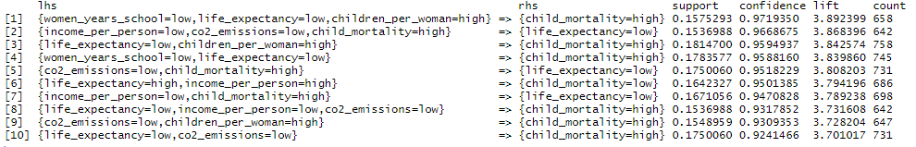
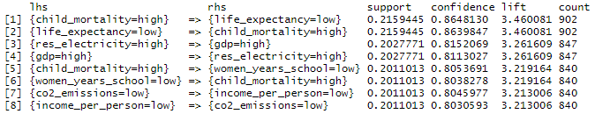
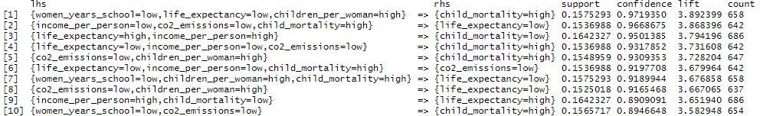
RULE LEARNING Results
Frequent Good Rules (supp = 0.15, conf = 0.5)
115 rules found
Maximally Frequent Good Rules
59 rules found
Frequent Great Rules (supp = 0.15, conf = 0.5)
8 rules found
Maximally Frequent Great Rules
Same 8 rules found

Slide 16
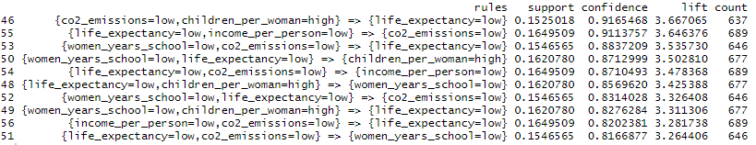
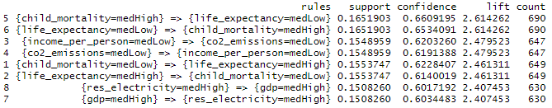
Looking for Interesting Rules
Filtering Child Mortality
115 -> 56 rules
medLow/medHigh Rules
115 -> 8 rules
Notes:
Lift is the same rules in different directions
Closed = no super-itemset with same support
Maximal = no frequent super-itemset

Slide 17
Rules Decade by decade
 | 70s | 80s | 90s | 00s
Frequent | 616 | 297 | 77 | 189
Maximally Frequent | 48 | 70 | 25 | 35
Notes:
Lift is the same rules in different directions
Closed = no super-itemset with same support
Maximal = no frequent super-itemset

Slide 18
QUESTIONS?
LOG NORMALIZATION
MIN-MAX NORMALIZATION

